Slide 1
Chapter 16
Users, usability, and web design

Slide 2
Objectives
Applied
Implement the usability guidelines that are in this chapter.
Knowledge
Describe the notion of usability and explain how the current website conventions contribute to usability.
Describe the primary principle for home-page design if you’re designing a small site for a relatively unknown company.
Describe three ways to let the users of a website know where they are.
Describe the use of chunking.
List three guidelines for typography on a web page.
List three guidelines for web writing.

Slide 3
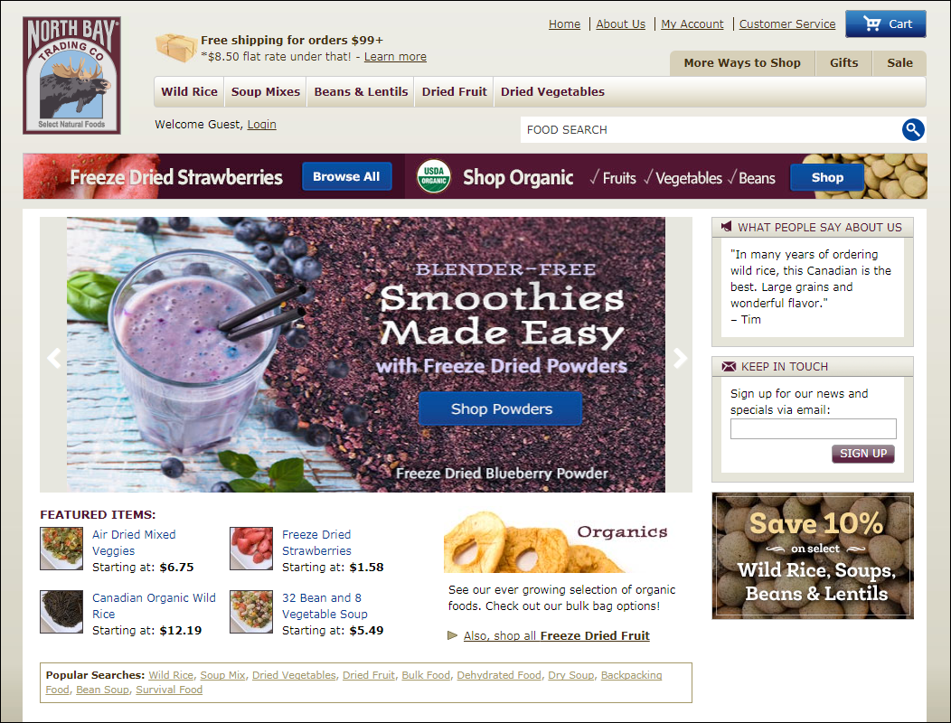
A website that is easy to use

Slide 4
What website users want
To find what they’re looking for as quickly and easily as possible
To get the information or do the task that they want to do as quickly and easily as possible

Slide 5
How website users use a web page
They scan the page to find what they’re looking for or a link to what they’re looking for.
They don’t like to scroll.
If they get frustrated, they leave.
They often click on links and buttons with the hope of finding what they’re looking for.
They frequently click on the Back button when they don’t find it.

Slide 6
Three guidelines for improving usability
Present all of the critical information “above the fold” so the user doesn’t have to scroll.
Group related items into separate components, and limit the number of components on each page.
Adhere to the current conventions for website usability.

Slide 7
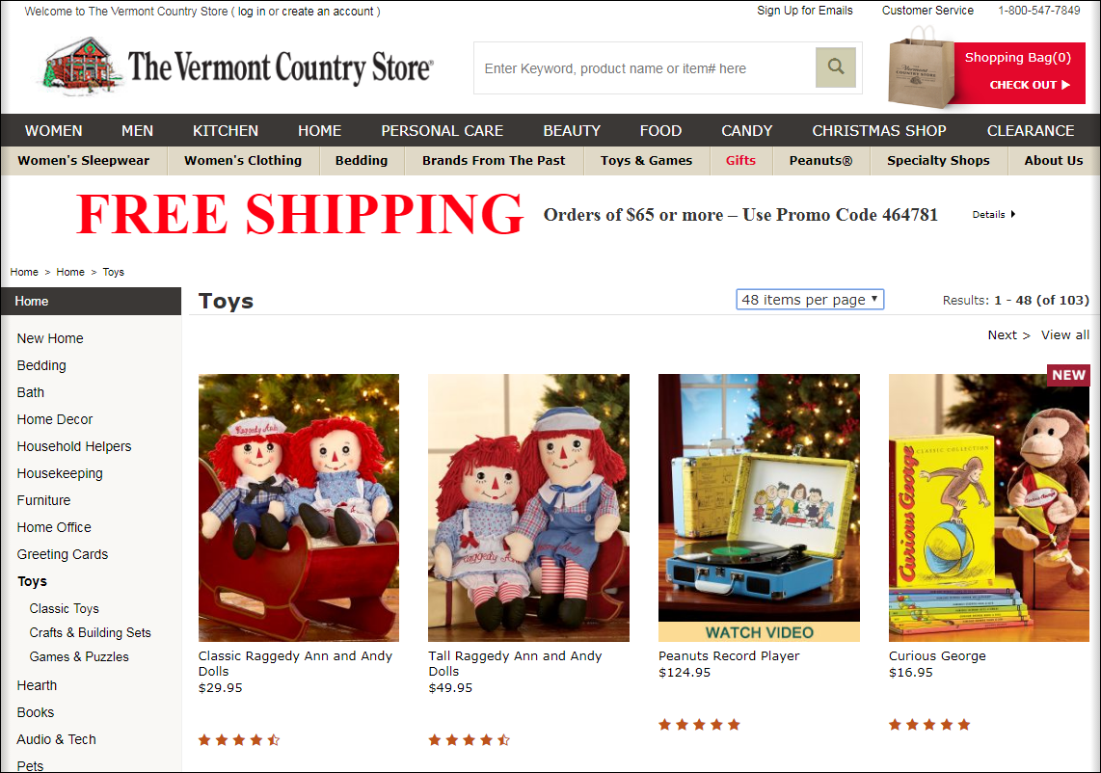
A web page that illustrates some of the current website conventions

Slide 8
Header conventions
The header consists of a logo, tag line, utilities, and a navigation bar.
The tag line identifies what’s unique about the website.
The navigation bar provides links that divide the site into sections.
The utilities consist of links to useful but not primary information.
If your site requires a search function, it should be in the header.
The search function should consist of a large text box for the entry followed by a search button.

Slide 9
Navigation conventions
Underlined text is always a link.
Images that are close to short text phrases are clickable.
Short text phrases in columns are clickable.
If you click on a cart symbol, you go to your shopping cart.
If you click on the logo in the header, you go to the home page.

Slide 10
The desktop view of the Lands’ End home page

Slide 11
The mobile view of the Lands’ End home page

Slide 12
The essence of mobile-first design
Design the mobile pages first.
Then, expand those designs for larger browsers.

Slide 13
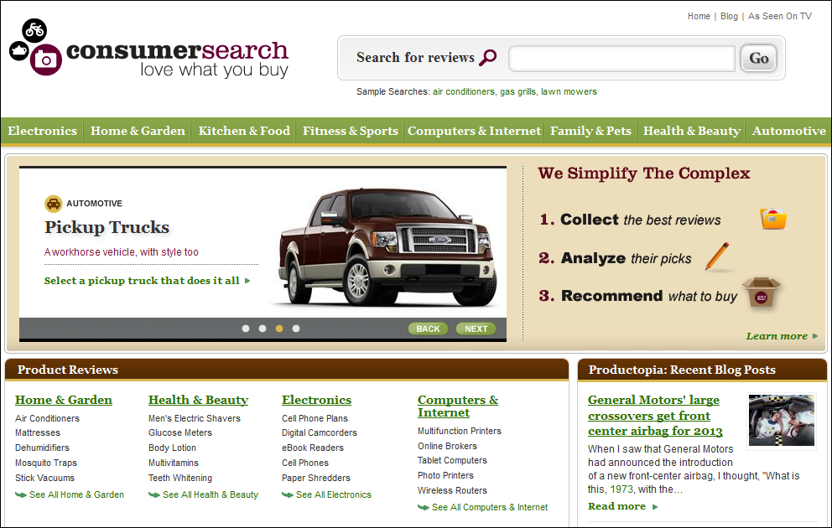
A home page that tries to sell the site

Slide 14
9 guidelines for developing an effective home page
Emphasize what your site offers that’s valuable and how your site differs from competing sites.
Emphasize the highest priority tasks of your site so users have a clear idea of what they can do.
Don’t welcome users to your site because that’s a waste of space.
Group items in the navigation areas so similar items are next to each other.
Only use icons for navigation if the users will readily recognize them.
Design the home page so it is different from the other pages of the site.
Don’t include an active link to the home page on the home page.

Slide 15
9 guidelines (continued)
Code the title element for the home page as the organization name, followed by a short description, and limit the title to 8 or fewer words and 64 or fewer characters.
If your site provides shopping, include a link to the shopping cart on your home page.

Slide 16
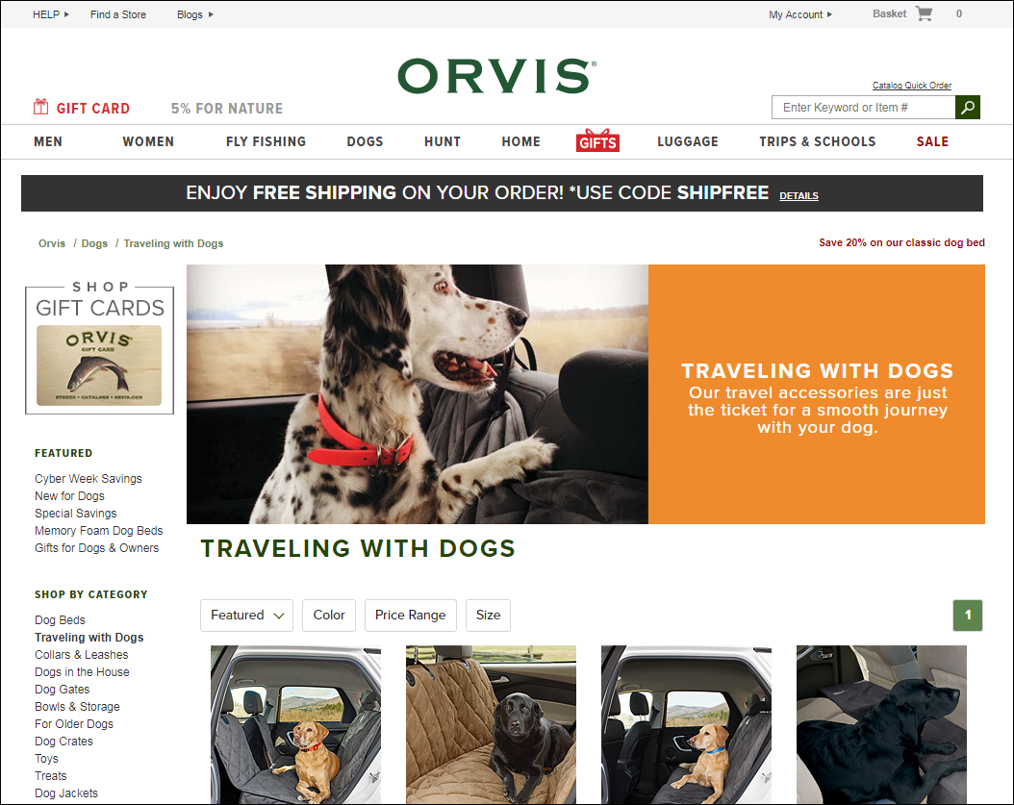
A page with breadcrumbs and highlighted links

Slide 17
How to let the users know where they are
Highlight the active links.
Make the heading for the page the same as the link that led to the page.
Provide breadcrumbs in this format:
Homepage > Dogs > Traveling with Dogs.

Slide 18
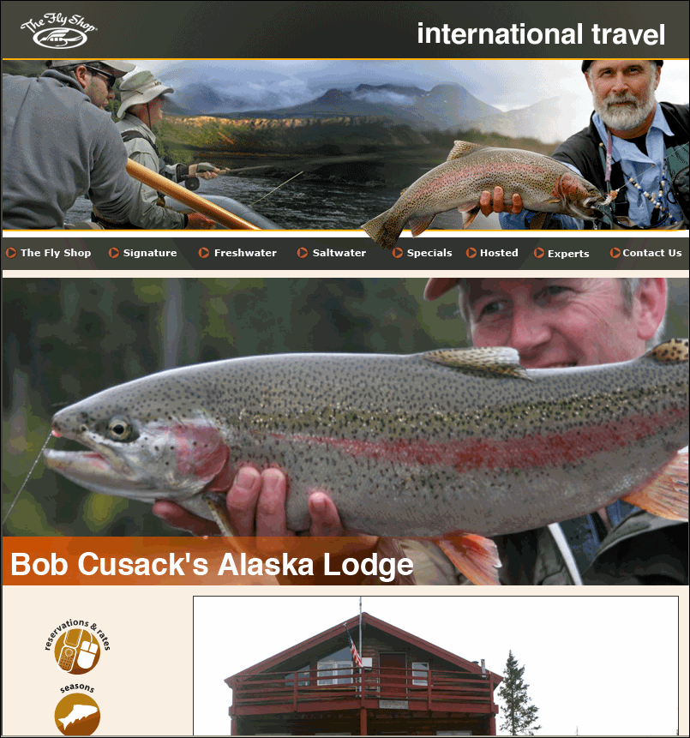
Wasted space on a primary page

Slide 19
Guidelines for the effective use of space
Keep the header relatively small.
Prioritize the components for each page.
Give the most important components the primary locations.

Slide 20
A home page that has been chunked

Slide 21
A page that illustrates good graphics design

Slide 22
Four principles of graphics design
Alignment means that related items on the page should line up with each other.
Proximity means that related items should be close together.
Repetition means that you should repeat some elements from page to page to give the pages continuity.
Contrast is what draws your eye to the components on a web page. If everything is the same, nothing stands out.

Slide 23
Typographical guidelines
Use a sans serif font in a size that’s large enough for easy reading.
Limit the line length of paragraphs to 65 characters.
Use dark text on a light background, and don’t use an image for the background.
Don’t center text and don’t justify text.
Don’t use reverse type (white type on a colored background) for text.
Avoid the use of all caps.

Slide 24
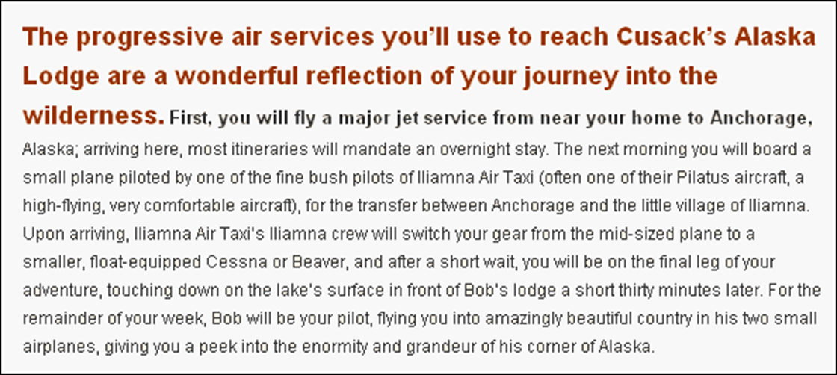
Writing that isn’t for the web (177 words and 1041 characters)

Slide 25
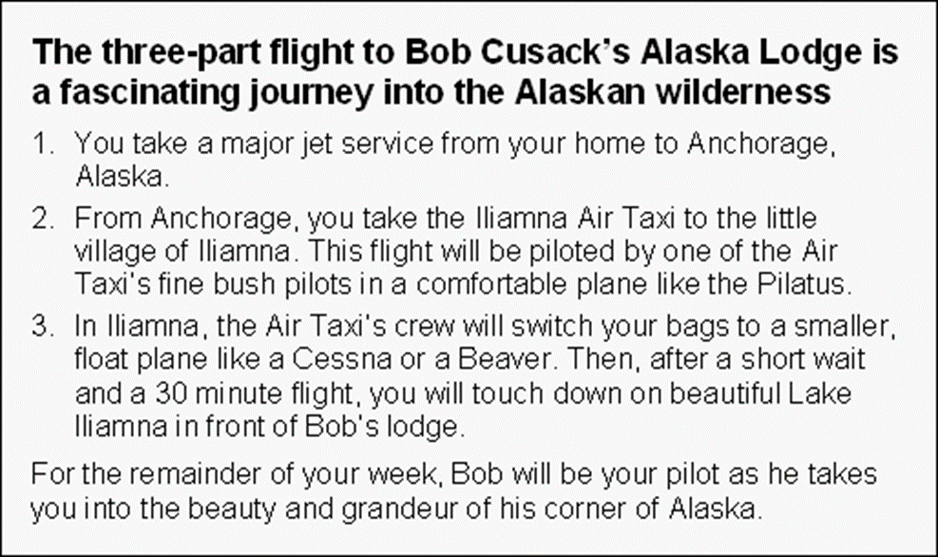
The same copy, but written for the web (135 words and 717 characters)

Slide 26
Web writing guidelines
Use fewer words.
Write in inverted pyramid style with the most important information first.
Use headings and subheadings to identify portions of the text.
Use bulleted lists and numbered lists to make information more accessible.
Use tables for tabular information.
Make the text for all links as explicit as possible.

